Slide 1
ARISTOTLE UNIVERSITY OF THESSALONIKI
FACULTY OF SCIENCES
SCHOOL OF INFORMATICS
POSTGRADUATE STUDIES PROGRAM ON INFORMATICS AND COMMUNICATIONS
SPECIALIZATION ON DIGITAL MEDIA AND COMPUTATIONAL INTELLIGENCE
Content-based Image Retrieval
Presenter: Efstathios Chatzikyriakidis
M.Sc. in Informatics and Communications
Specialization in Computational Intelligence and Digital Media
School of Informatics, Faculty of Sciences
Aristotle University of Thessaloniki, Hellas
B.Sc. in Informatics and Communications
Specialization in Software Engineering
Department of Informatics and Communications, Faculty of Applied Technology
Technological Educational Institute of Central Macedonia, Hellas
Email : contact@efxa.org Website : http://www.efxa.org/

Slide 2
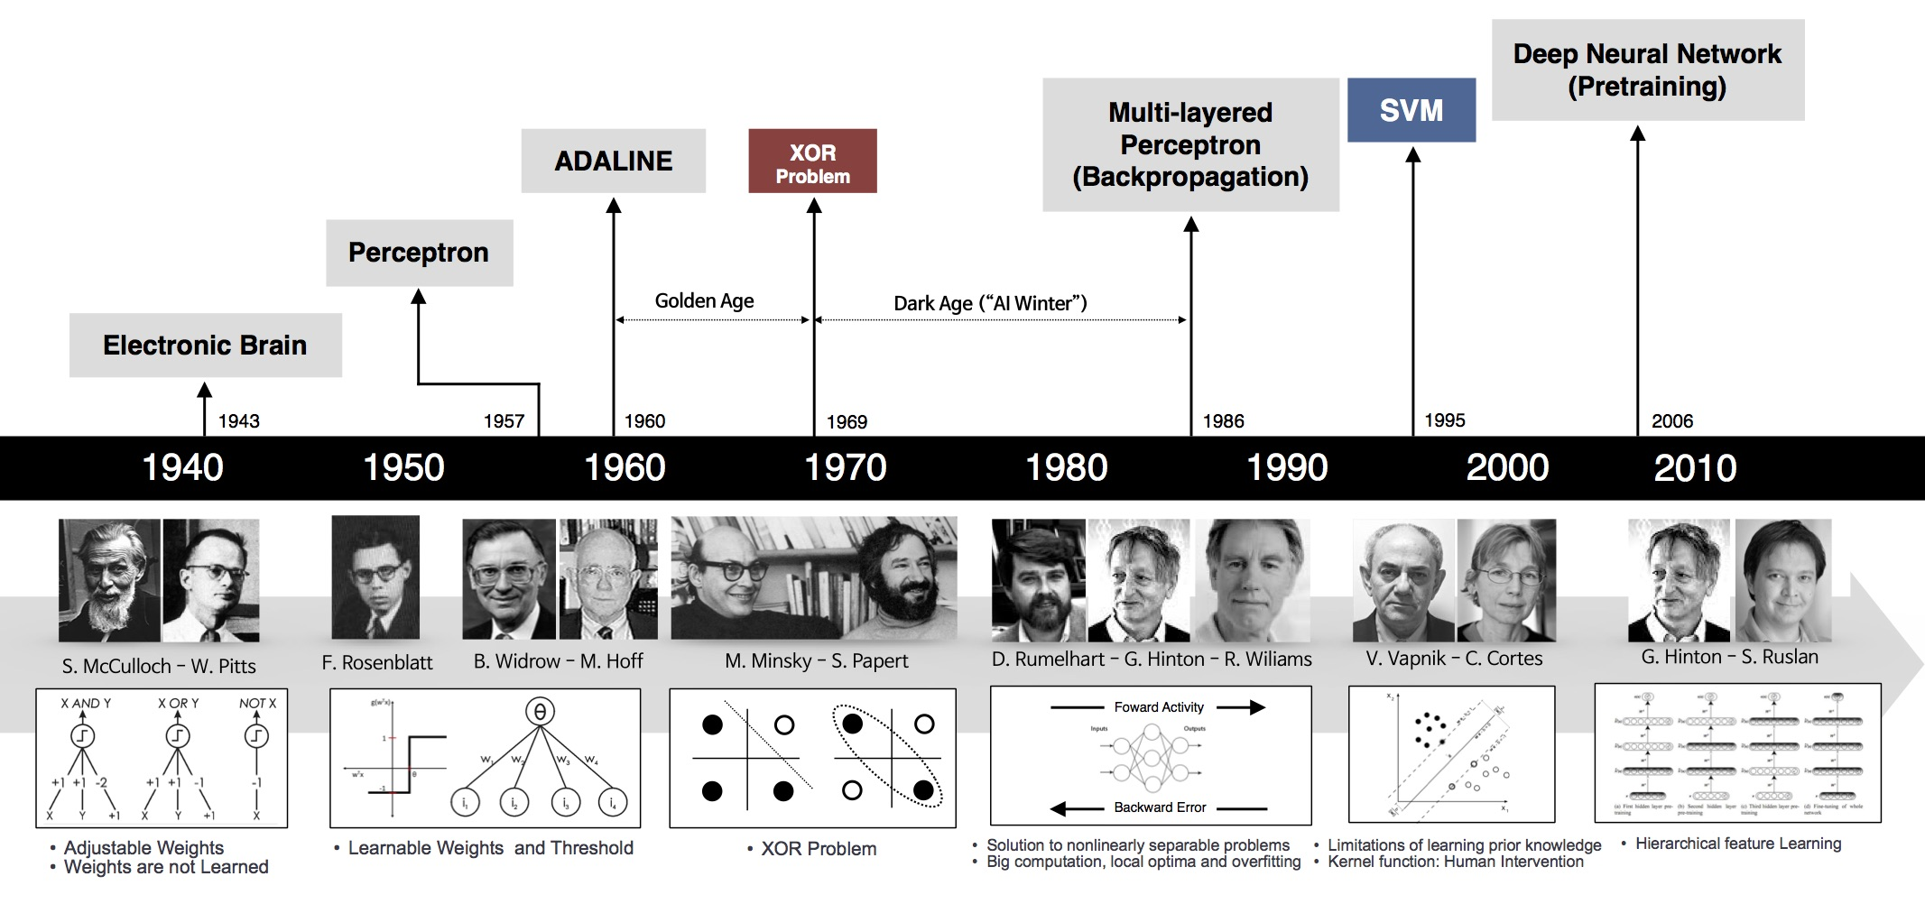
Introduction
Important history of “Artificial Intelligence”
We had a long journey… and we are still at the birth of it...

Slide 3
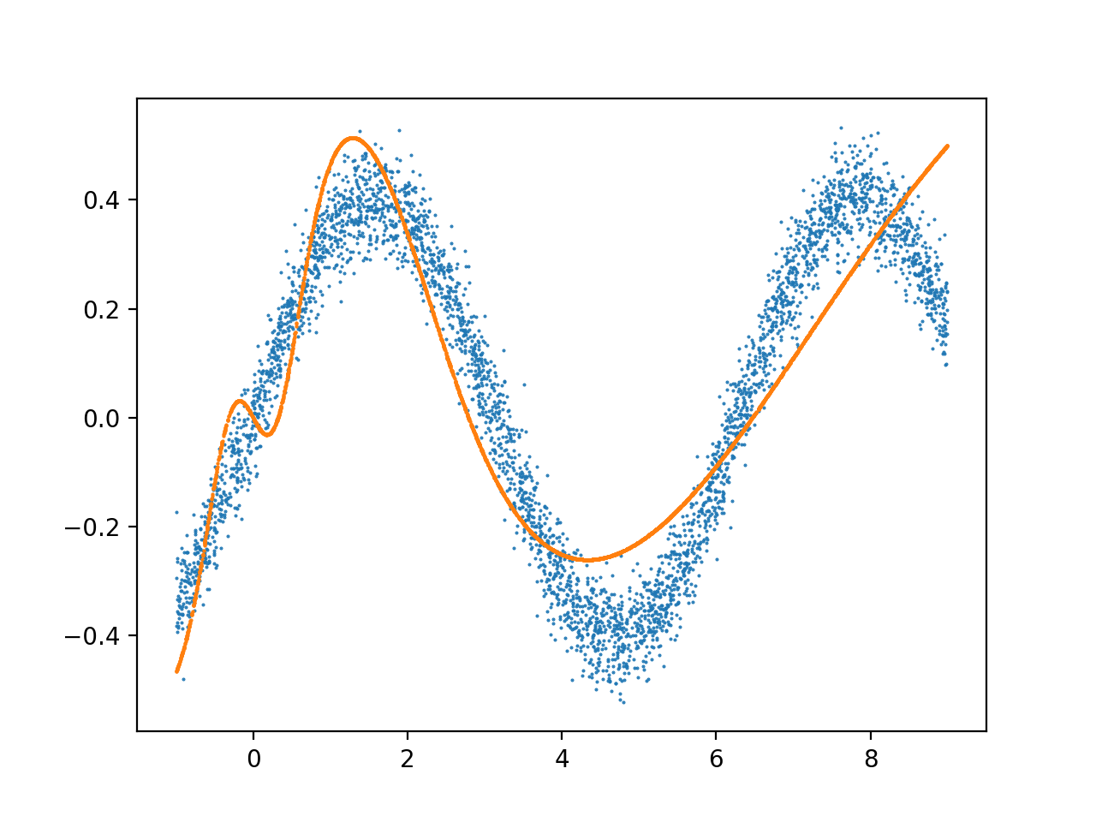
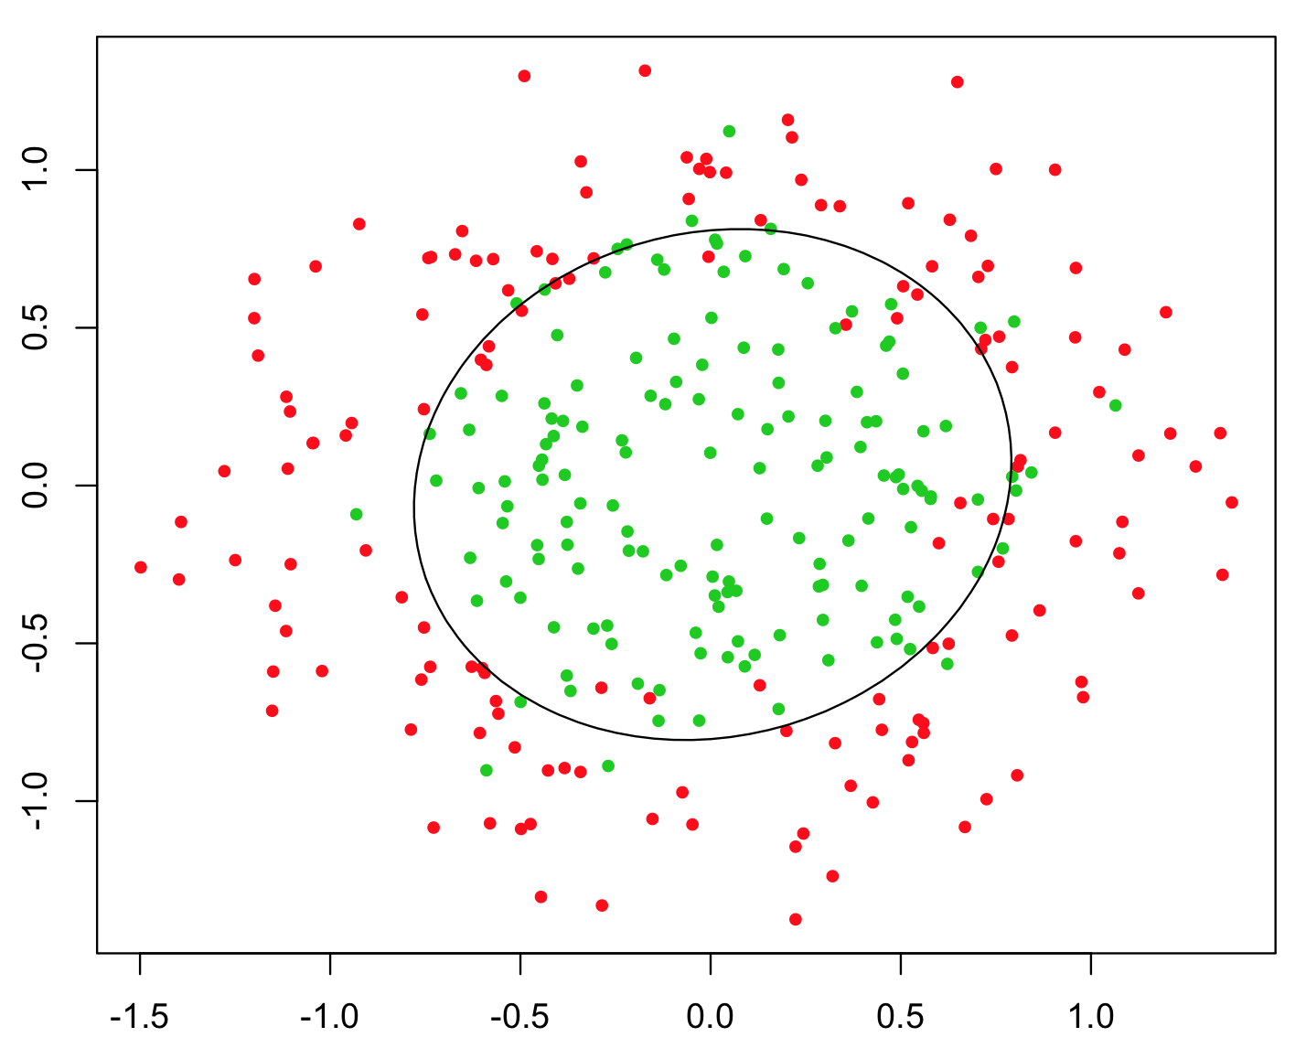
Introduction
Αdvantages of Artificial Neural Networks
Satisfactory separation of non-linear separable input data
Satisfactory function approximation using only input data

Slide 4
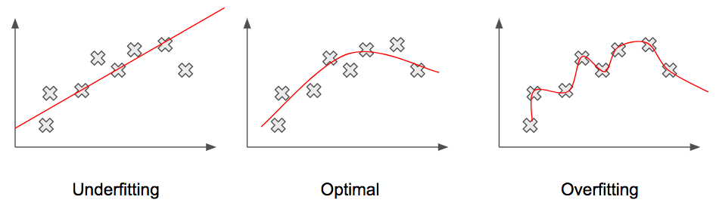
Introduction
Αdvantages of Artificial Neural Networks
Good generalization that captures the general manifold of data

Slide 5
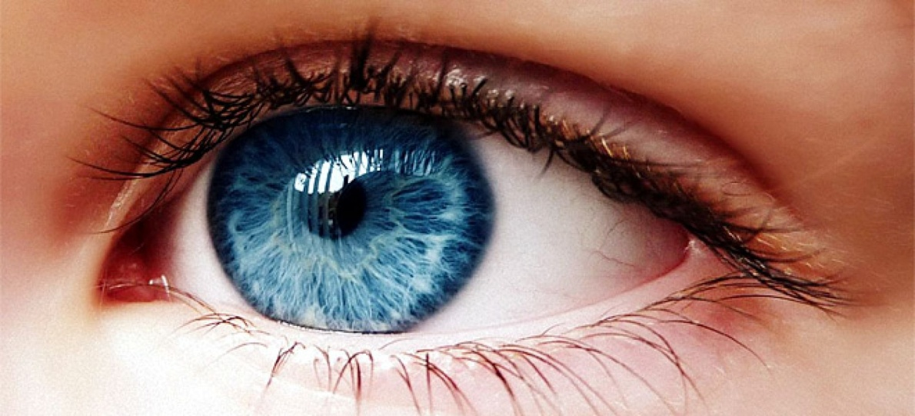
Introduction
Computer Vision and its future goal
The strongest sense of most animal species
Simulate how brains see and understand the world through vision sense

Slide 6
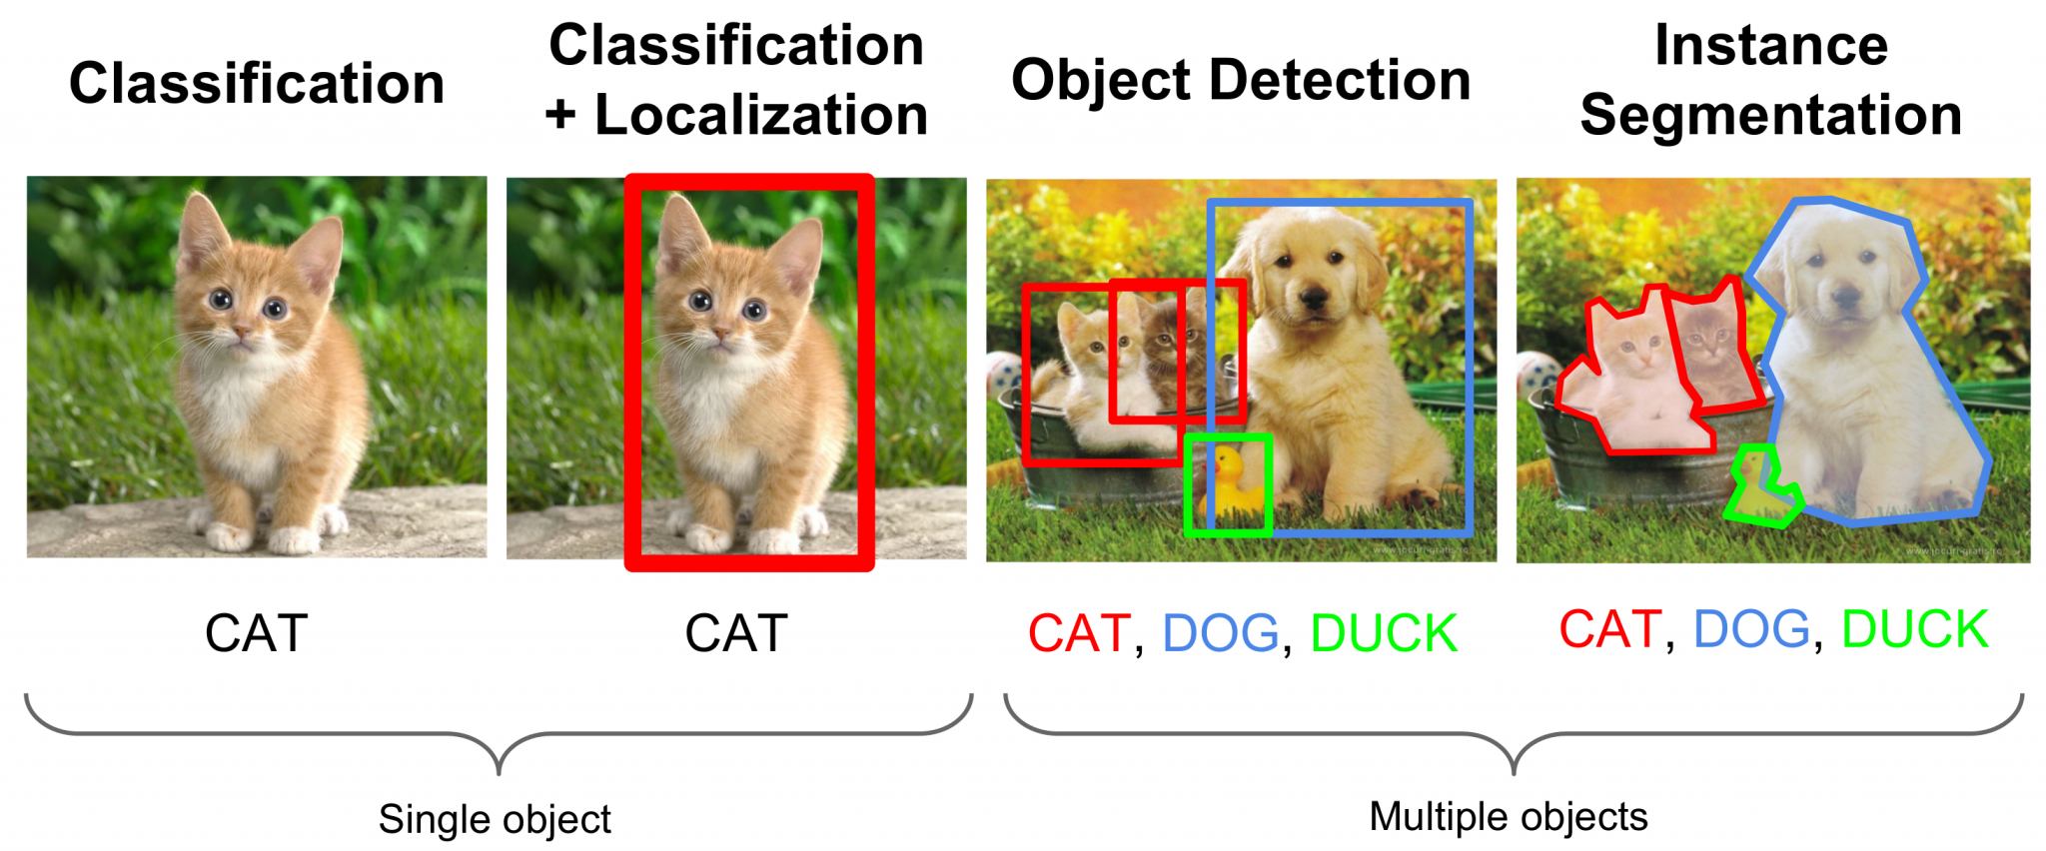
Computer Vision
Well-known tasks of high-level image understanding

Slide 7
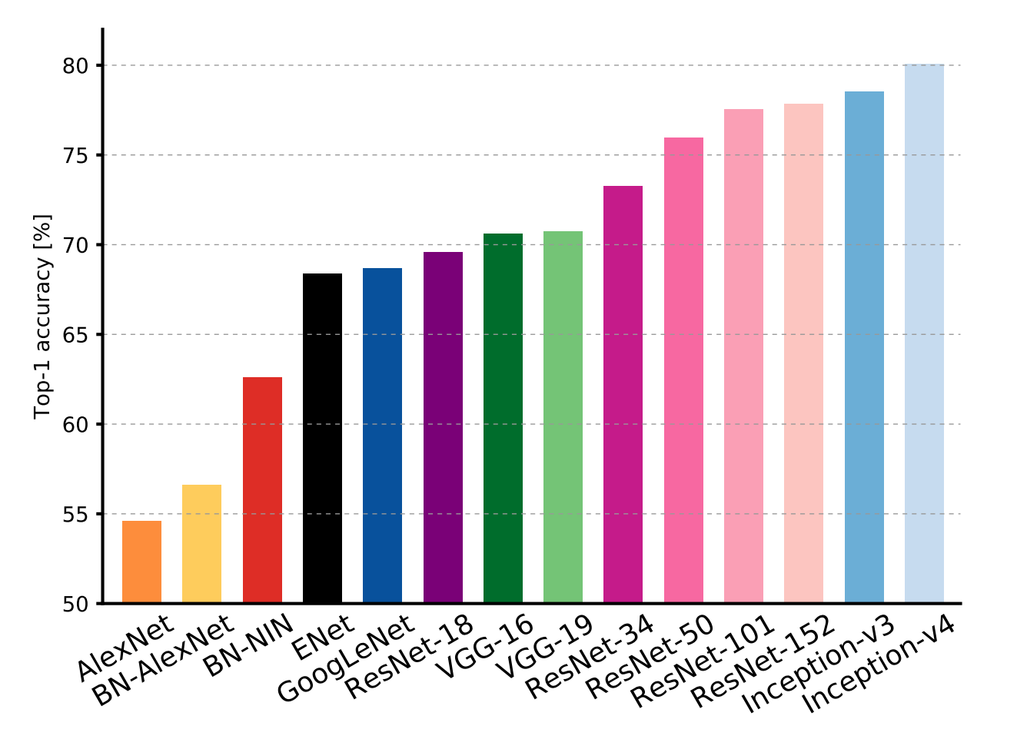
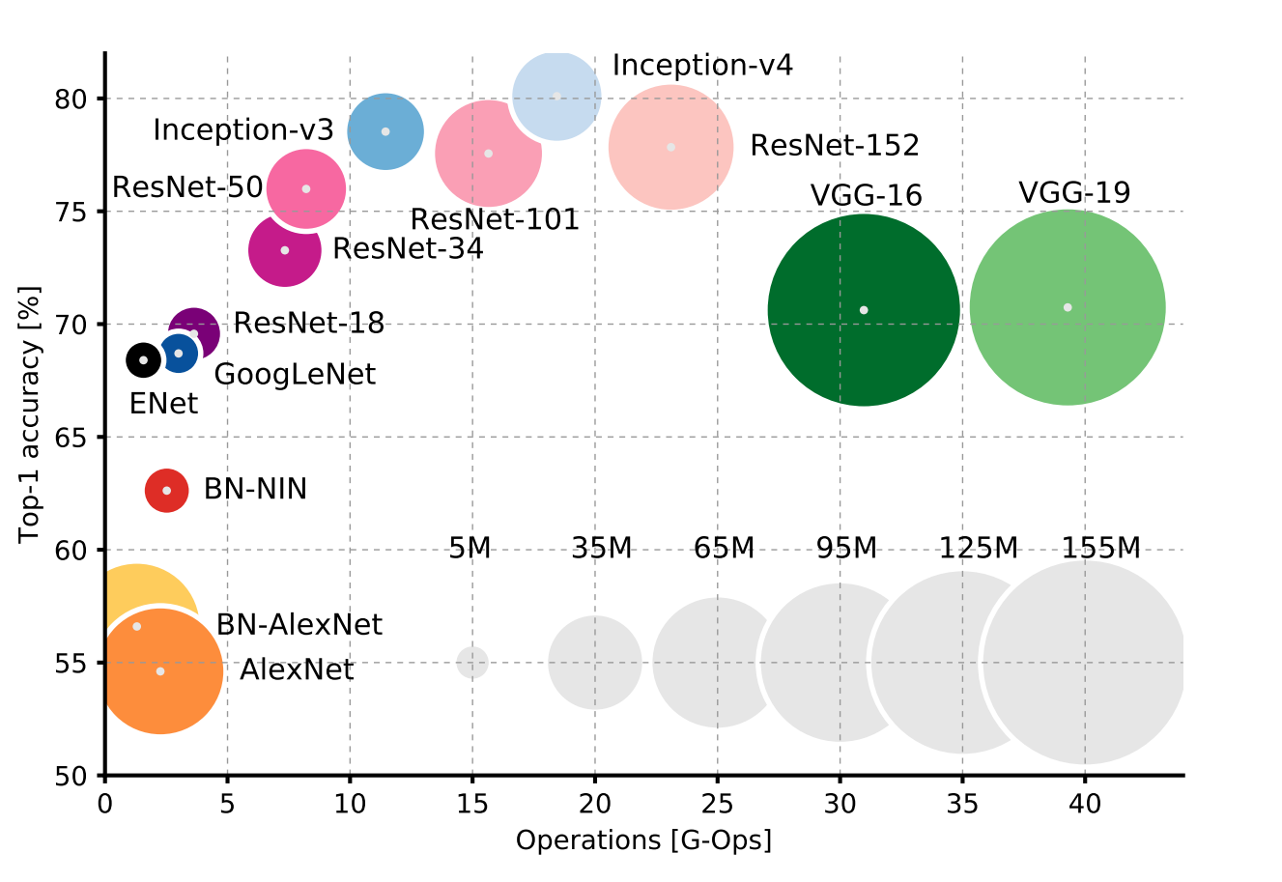
Computer Vision
State-of-the-art Image Classification
ImageNet Large Scale Visual Recognition Challenge (ILSVRC)

Slide 8
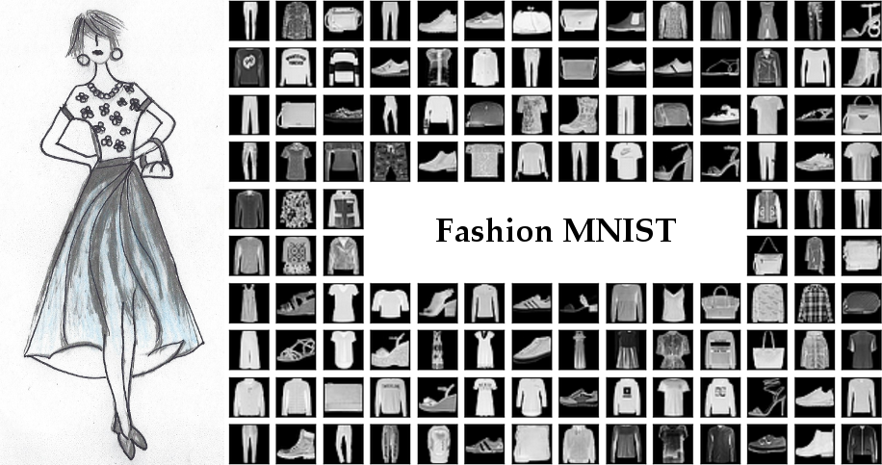
Dataset
Fashion MNIST

Slide 9
Dataset
Fashion MNIST
Characteristics:
70000 total grayscale images
28x28 pixels image resolution
10 total class labels
60000 training images (6000 images per class label)
10000 testing images (1000 images per class label)

Slide 10
Dataset
Fashion MNIST
Class labels:
T-shirt/top
Trouser
Pullover
Dress
Coat
Sandal
Shirt
Sneaker
Bag
Ankle boot

Slide 11
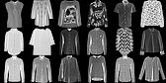
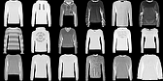

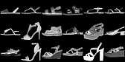
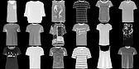
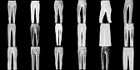
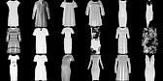
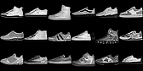
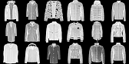
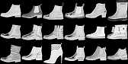
Dataset
Fashion MNIST

Slide 12
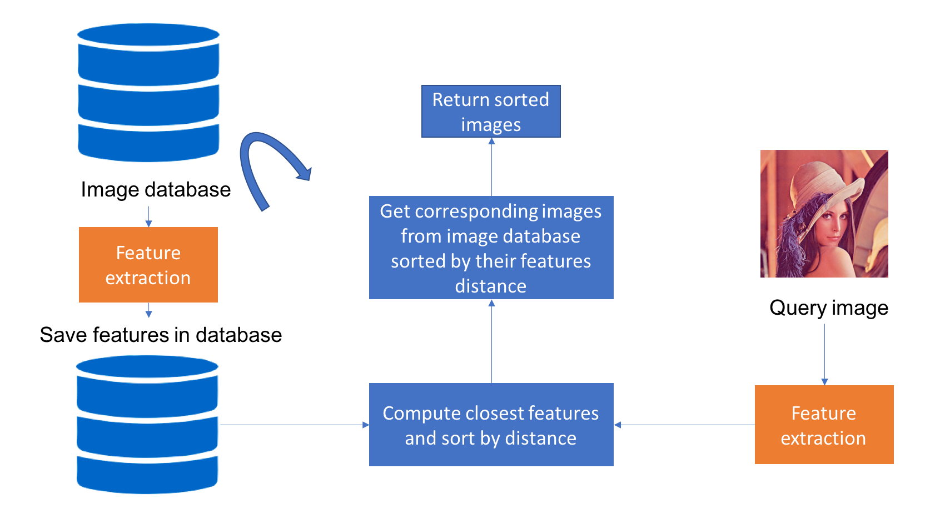
Content-based Image Retrieval (CBIR)
The general idea

Slide 13
A simple CBIR prototype
Using a convolutional deep neural network and the KNN algorithm
Steps:
Train a convolutional deep neural network with the Fashion MNIST for multi-label classification
Extract the feature vectors of all dataset images as represented internally in the neural network
Store the extracted image feature vectors in a feature database
Fit a KNN model using the extracted image feature vectors stored in the feature database
For an input query image:
Extract its image feature vector using the same technique used in step 2
Use the KNN model to find the closest K neighbor images using a distance metric
Present the closest K images sorted by distance

Slide 14
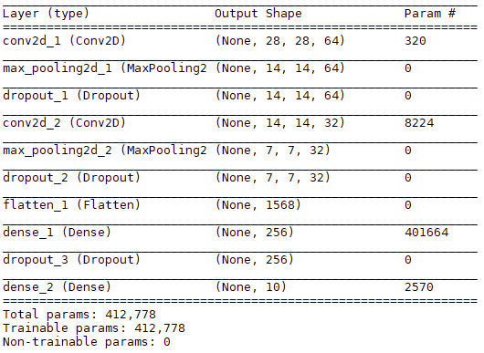
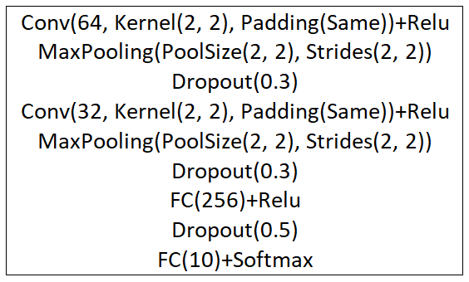
Convolutional Neural Network Classifier
Summary and architecture of the neural network

Slide 15
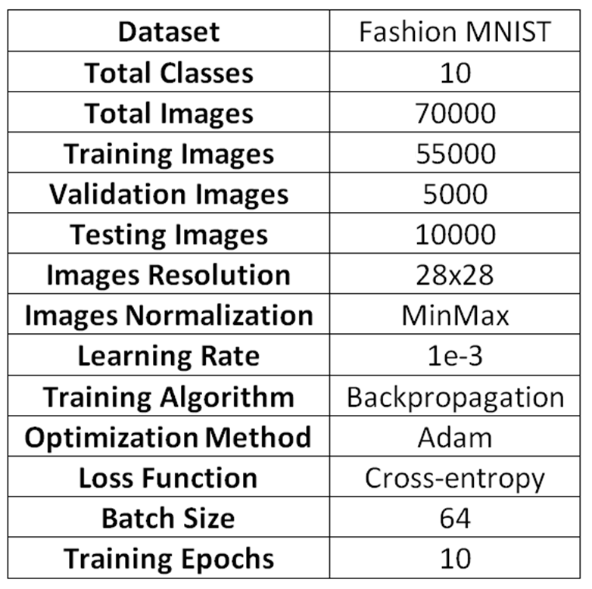
Convolutional Neural Network Classifier
Training information

Slide 16
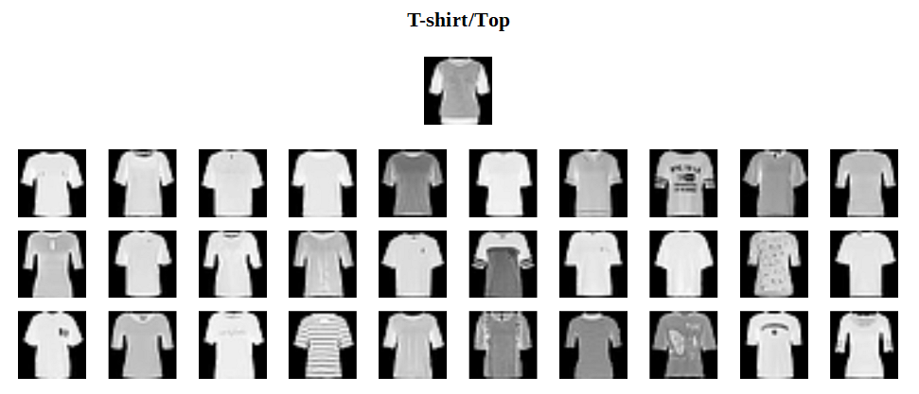
Example Queries
Example 1 (closest K=30 neighbors)

Slide 17
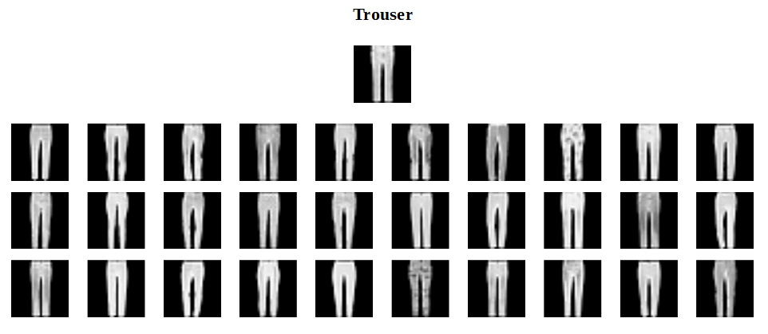
Example Queries
Example 2 (closest K=30 neighbors)

Slide 18
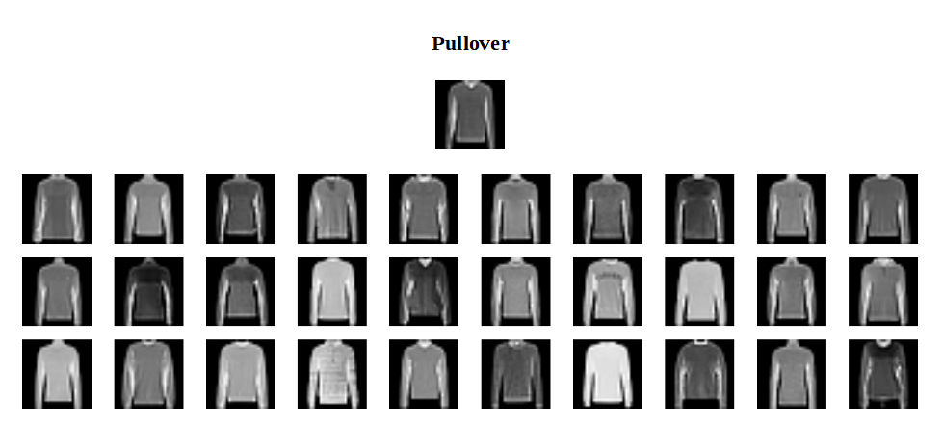
Example Queries
Example 3 (closest K=30 neighbors)

Slide 19
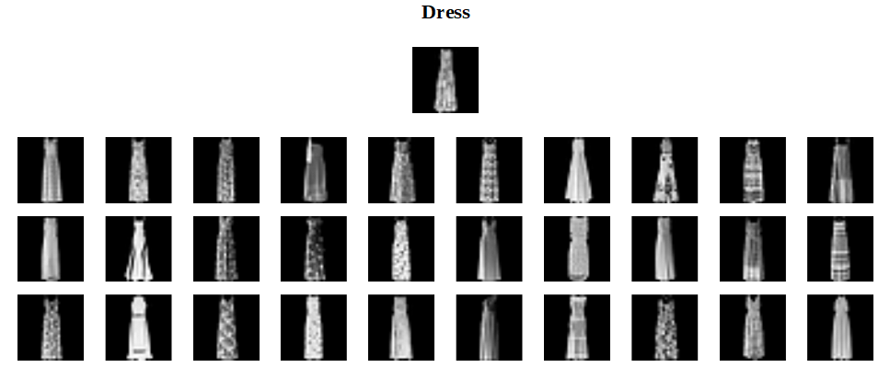
Example Queries
Example 4 (closest K=30 neighbors)

Slide 20
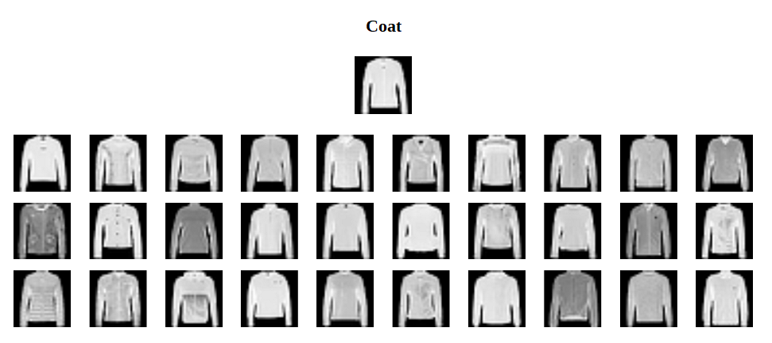
Example Queries
Example 5 (closest K=30 neighbors)

Slide 21
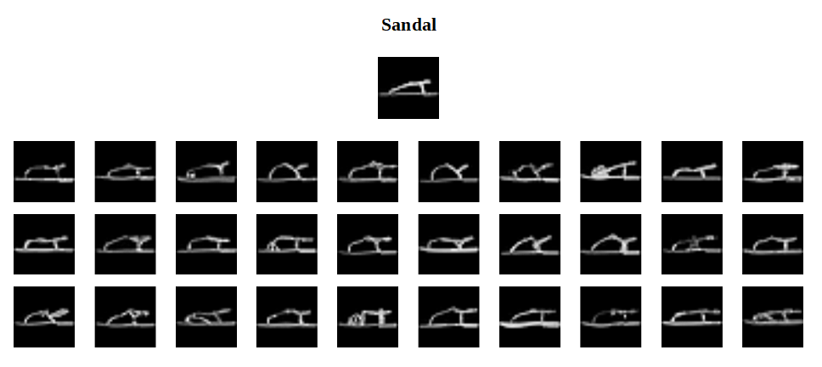
Example Queries
Example 6 (closest K=30 neighbors)

Slide 22
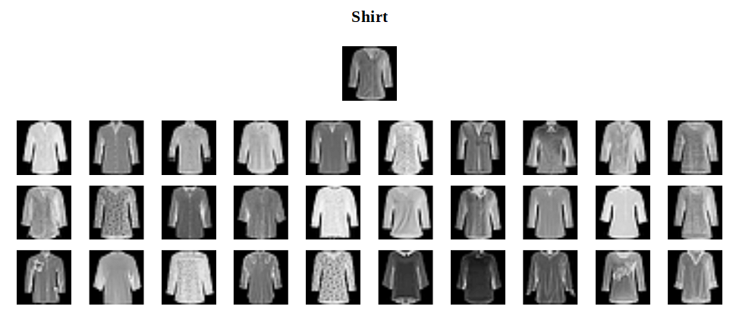
Example Queries
Example 7 (closest K=30 neighbors)

Slide 23
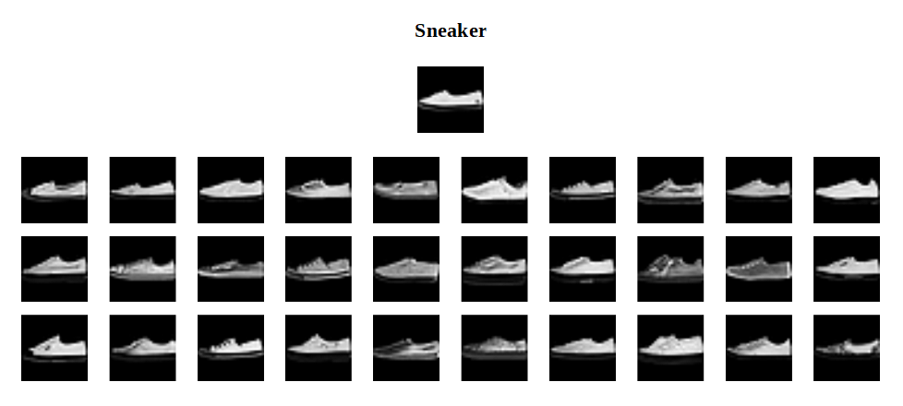
Example Queries
Example 8 (closest K=30 neighbors)

Slide 24
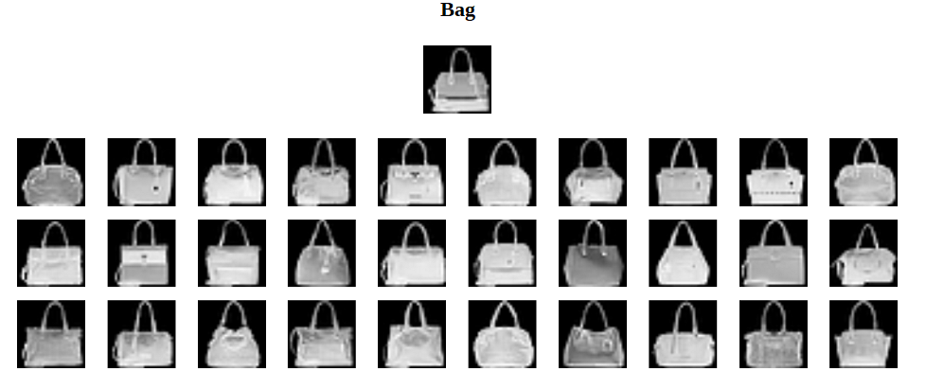
Example Queries
Example 9 (closest K=30 neighbors)

Slide 25
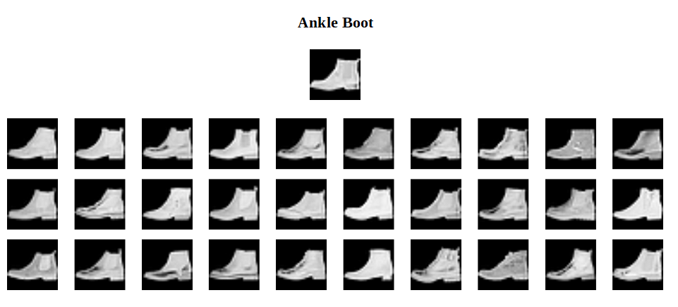
Example Queries
Example 10 (closest K=30 neighbors)

Slide 26
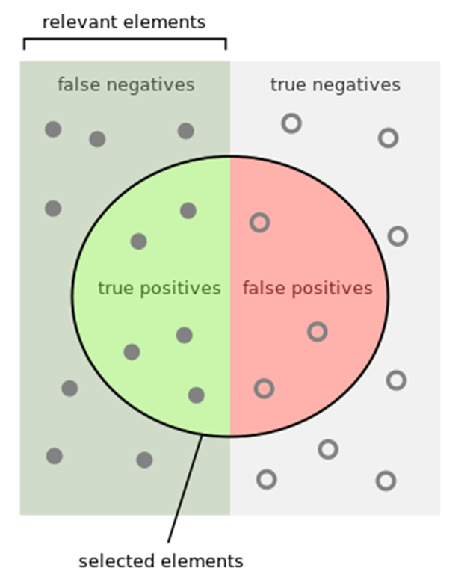

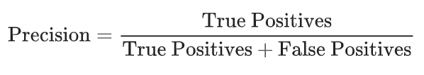
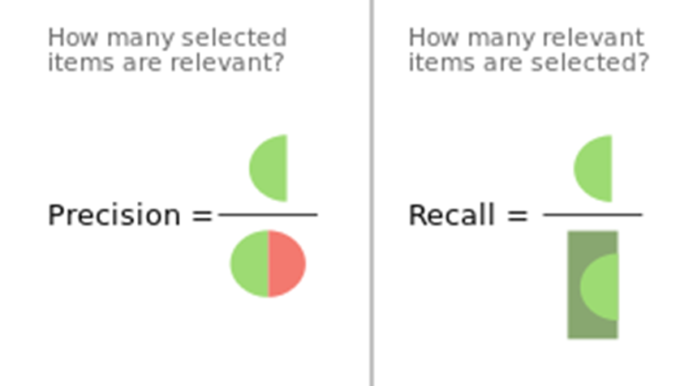
Metrics
Precision & Recall

Slide 27
Experiments
Using various similarity metrics, neural network layers, K sizes
We have calculated average precision and recall metrics for experiments using:
100 different random test images as search input queries
various K sizes ranging from 1 to 500
features vectors extracted from various neural network layers
various similarity metrics (Cosine, Euclidean, etc)

Slide 28
Results
The experimental results are stored in a CSV file
CSV file format:
Neural Network Layer, Similarity Metric, K size, Avg Precision (%), Avg Recall (%)
flatten_1, euclidean, 1, 87.0, 0.015
…
…
flatten_1, cosine, 500, 71.6, 5.970
...
…
dense_1, euclidean, 1, 94.0, 0.016
...
…
dense_1, cosine, 500, 84.8, 7.074

Slide 29
Results
Conclusions
When K size increases the precision decreases
When K size increases the recall increases
The feature vectors extracted from 'dense_1' layer give better precision, recall results
The cosine similarity gives better precision, recall results
In general there is a trade-off between precision and recall metrics

Slide 30
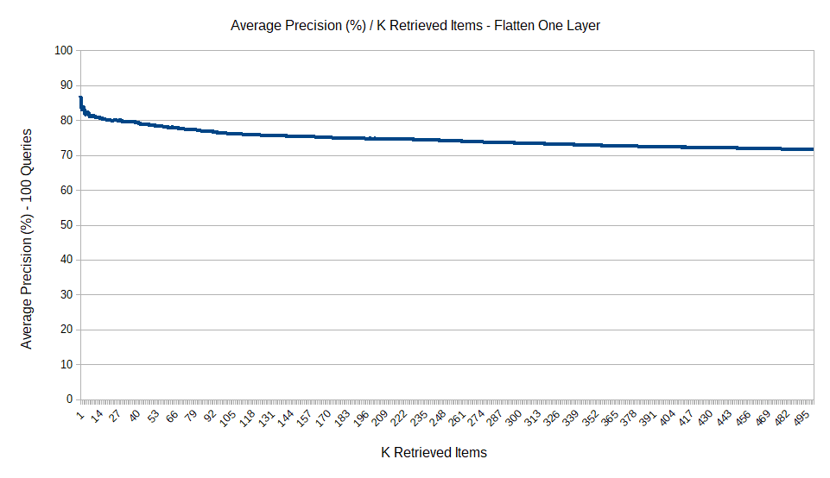
Curves
Average Precision / K Retrieved Items (for flatten_1 layer)

Slide 31
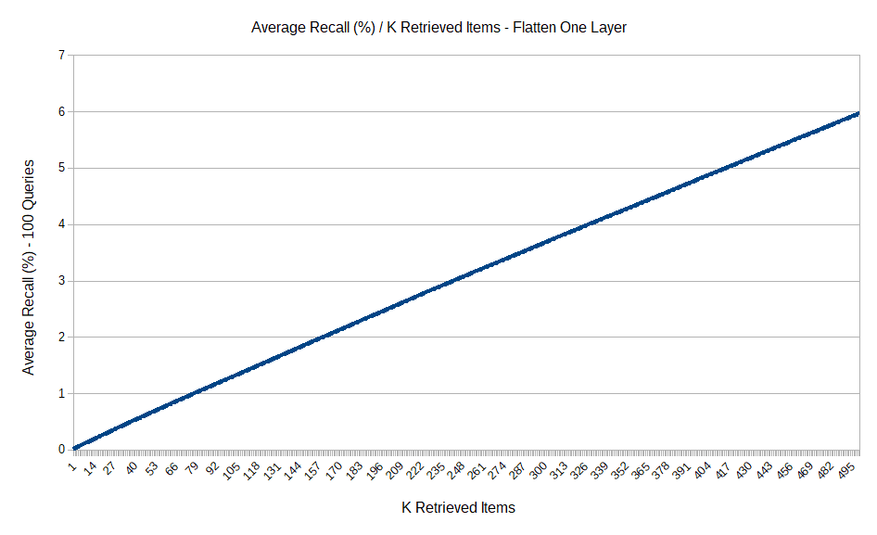
Curves
Average Recall / K Retrieved Items (for flatten_1 layer)

Slide 32
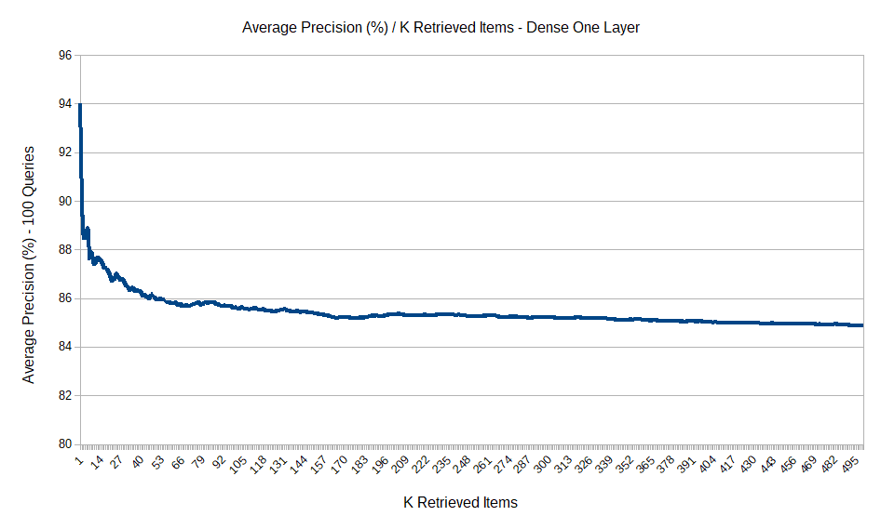
Curves
Average Precision / K Retrieved Items (for dense_1 layer)

Slide 33
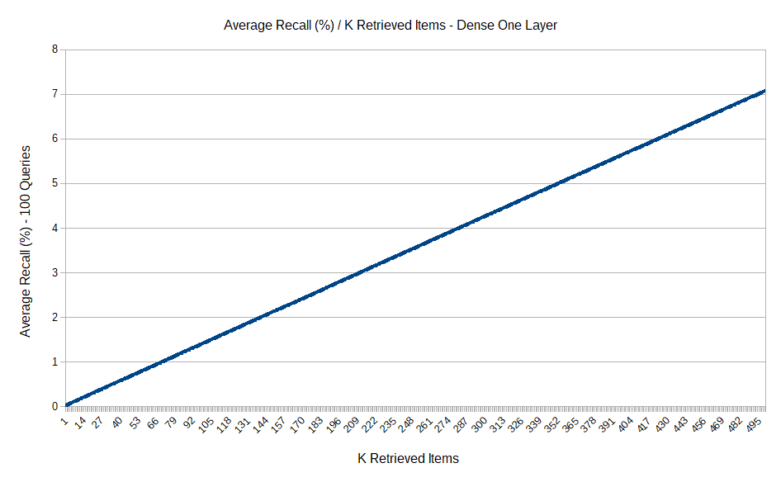
Curves
Average Recall / K Retrieved Items (for dense_1 layer)

Slide 34
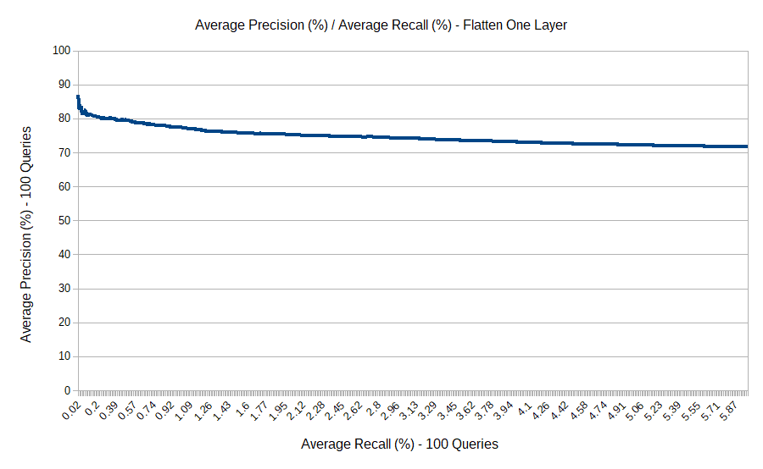
Curves
Average Precision / Average Recall (for flatten_1 layer)

Slide 35
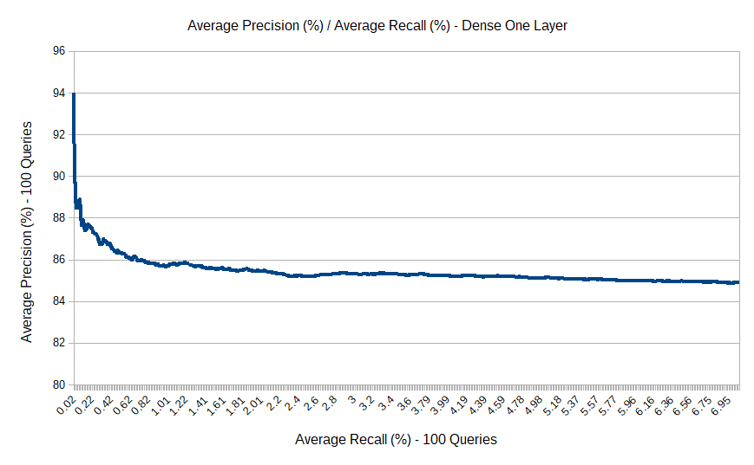
Curves
Average Precision / Average Recall (for dense_1 layer)

Slide 36
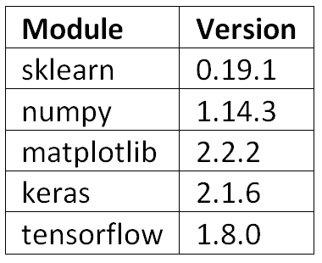
Software Requirements
Programming Languages : Python
IDE : Spyder, JetBrains PyCharm
Application-level Dependency Manager: Anaconda
Python Modules :

Slide 37
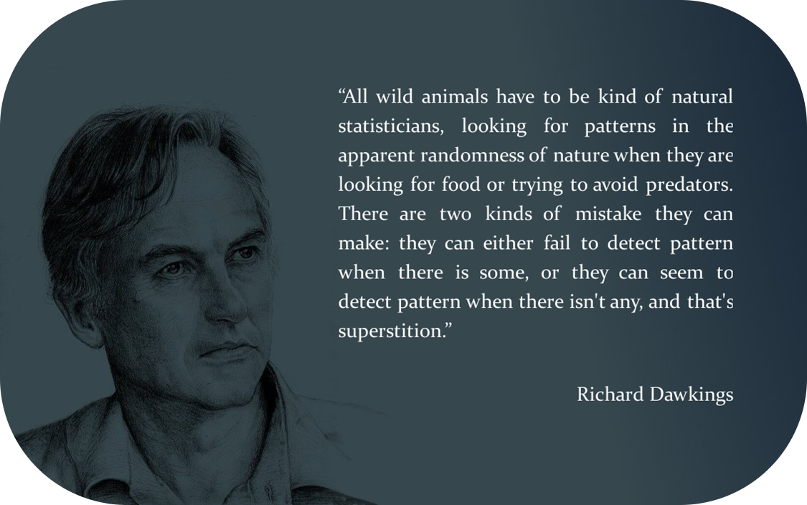
Thank you a lot and have a nice day!

